Slide 1



Report - Legal Business + Operations Content Consumption Survey
View in Power BI
Last data refresh:
8/8/2018 10:42:27 AM Pacific Standard Time
Downloaded at:
8/8/2018 10:43:28 AM Pacific Standard Time

Slide 2
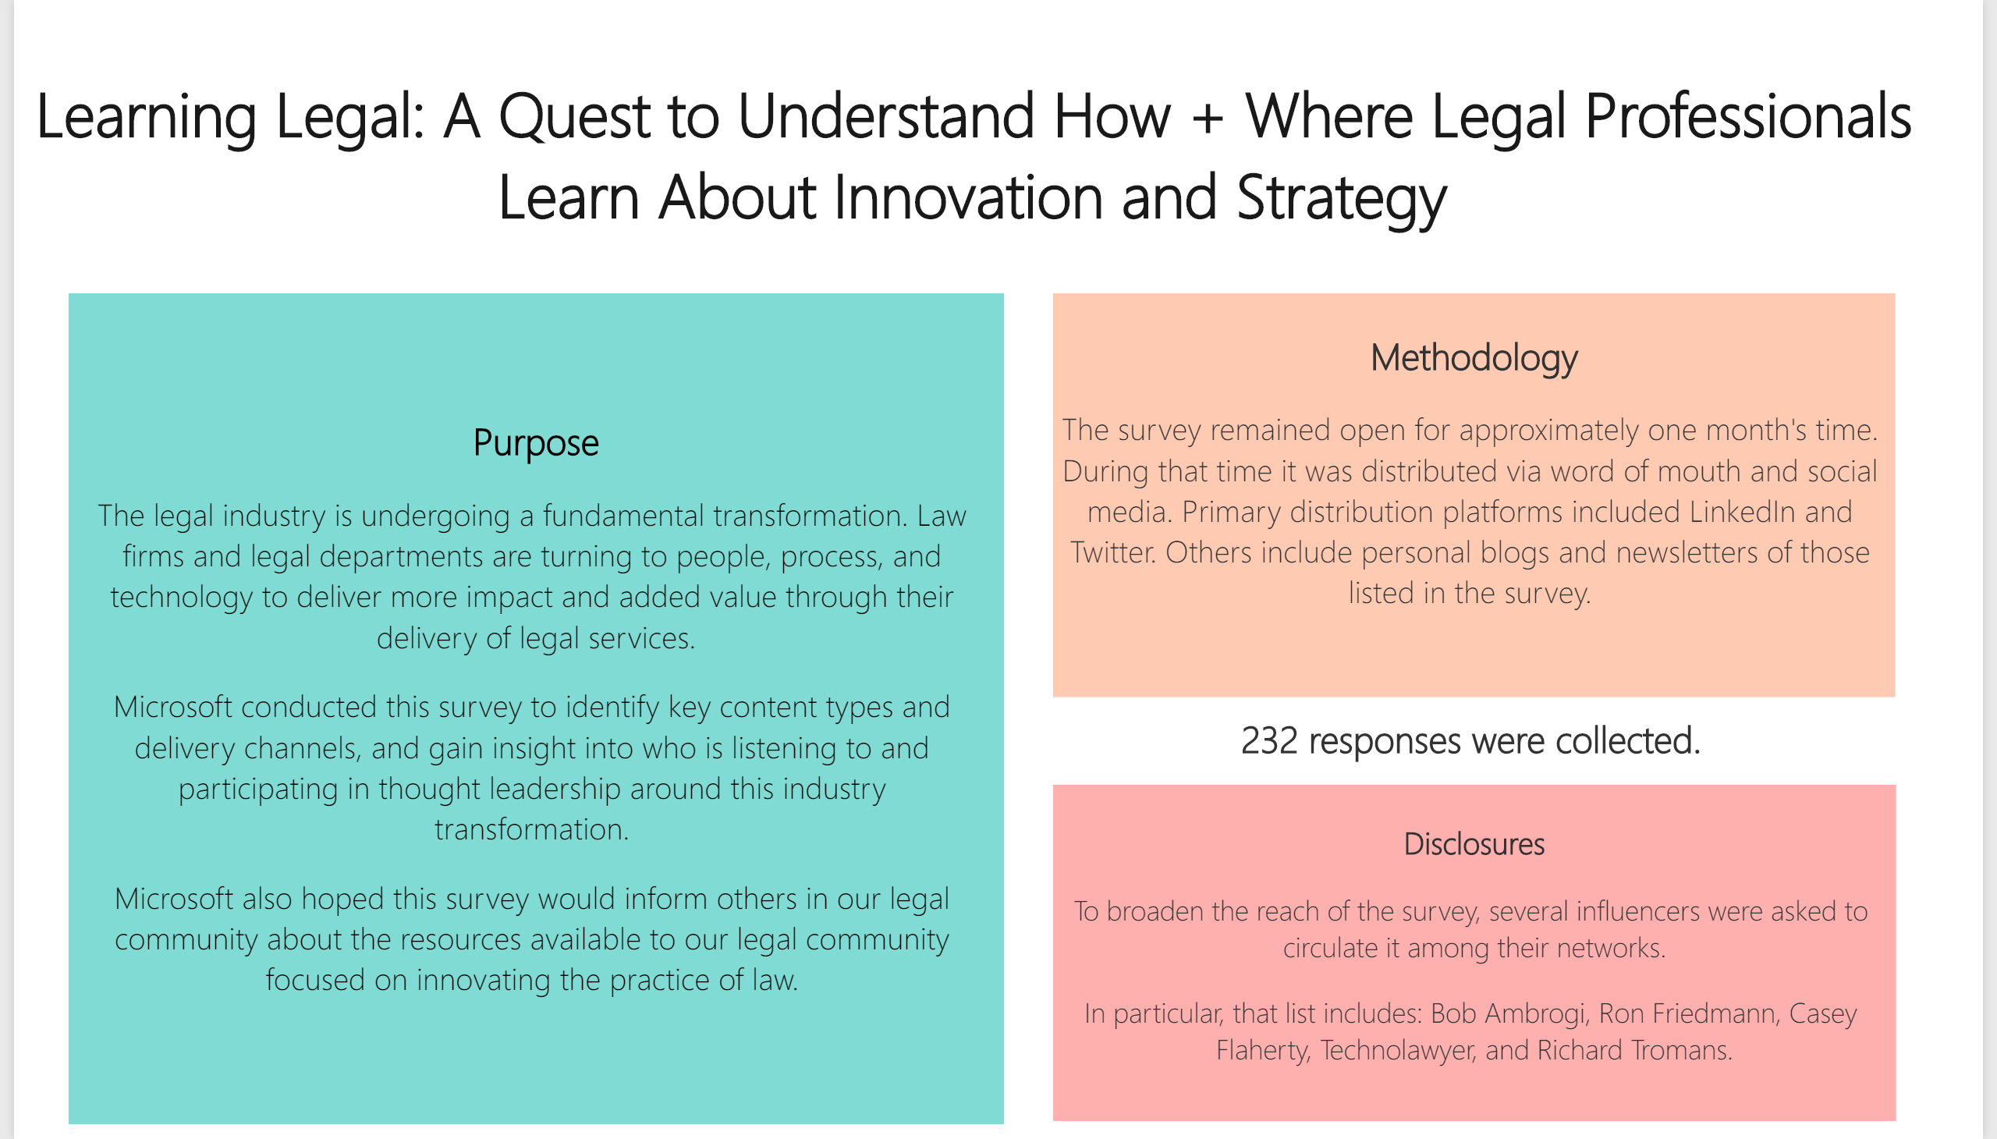

Slide 3
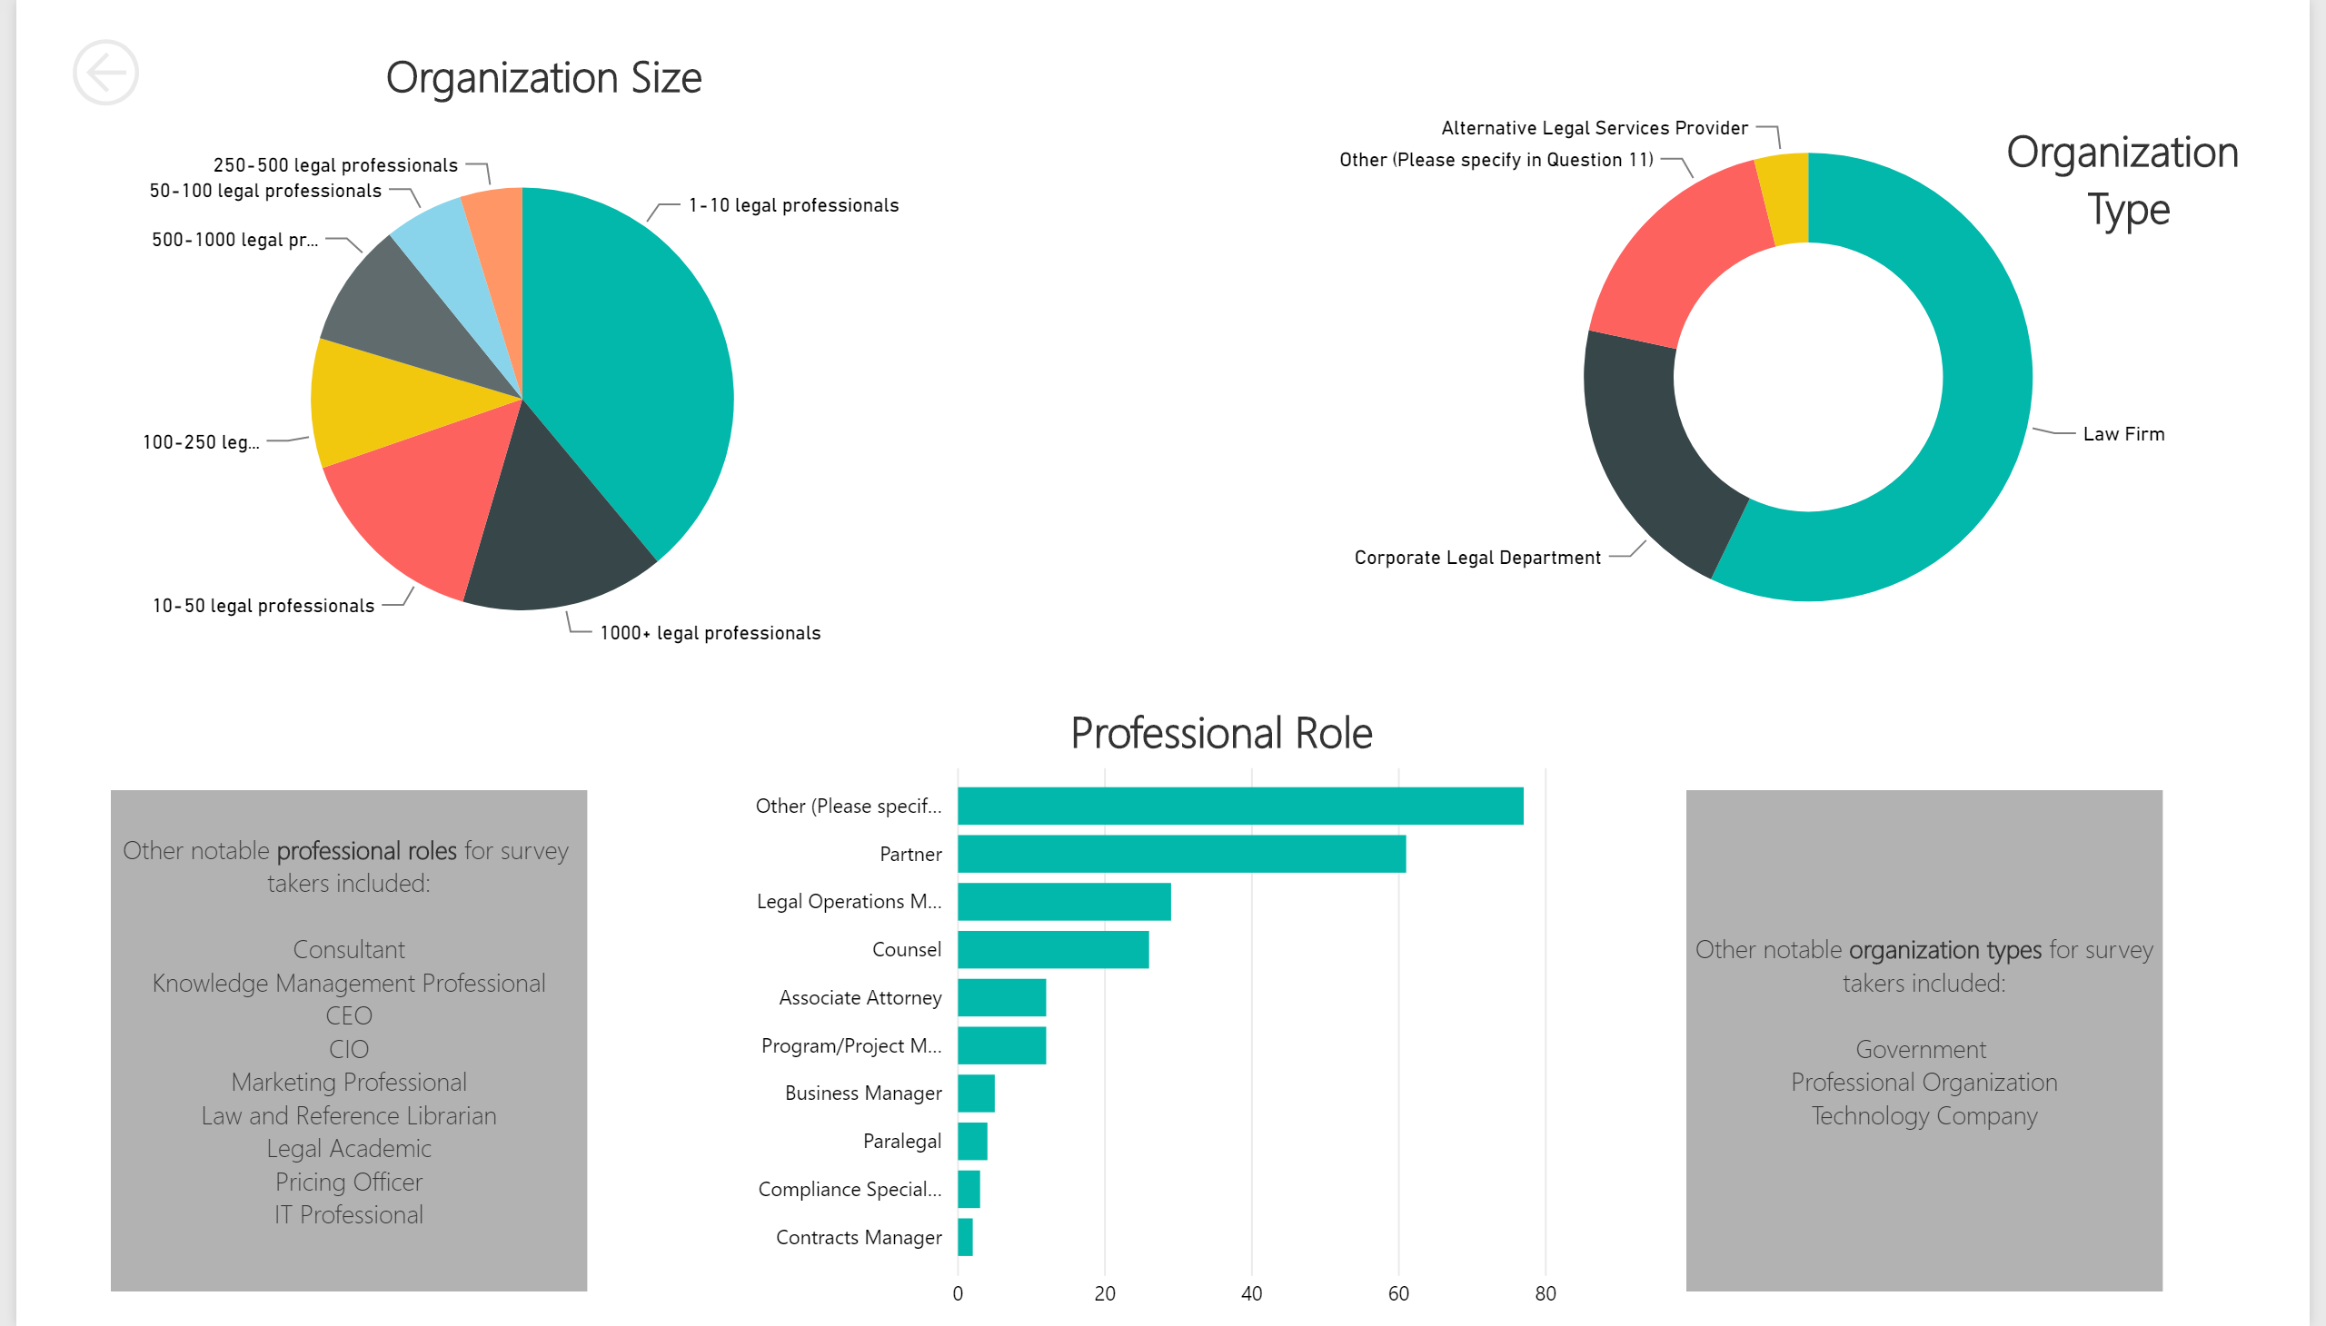

Slide 4
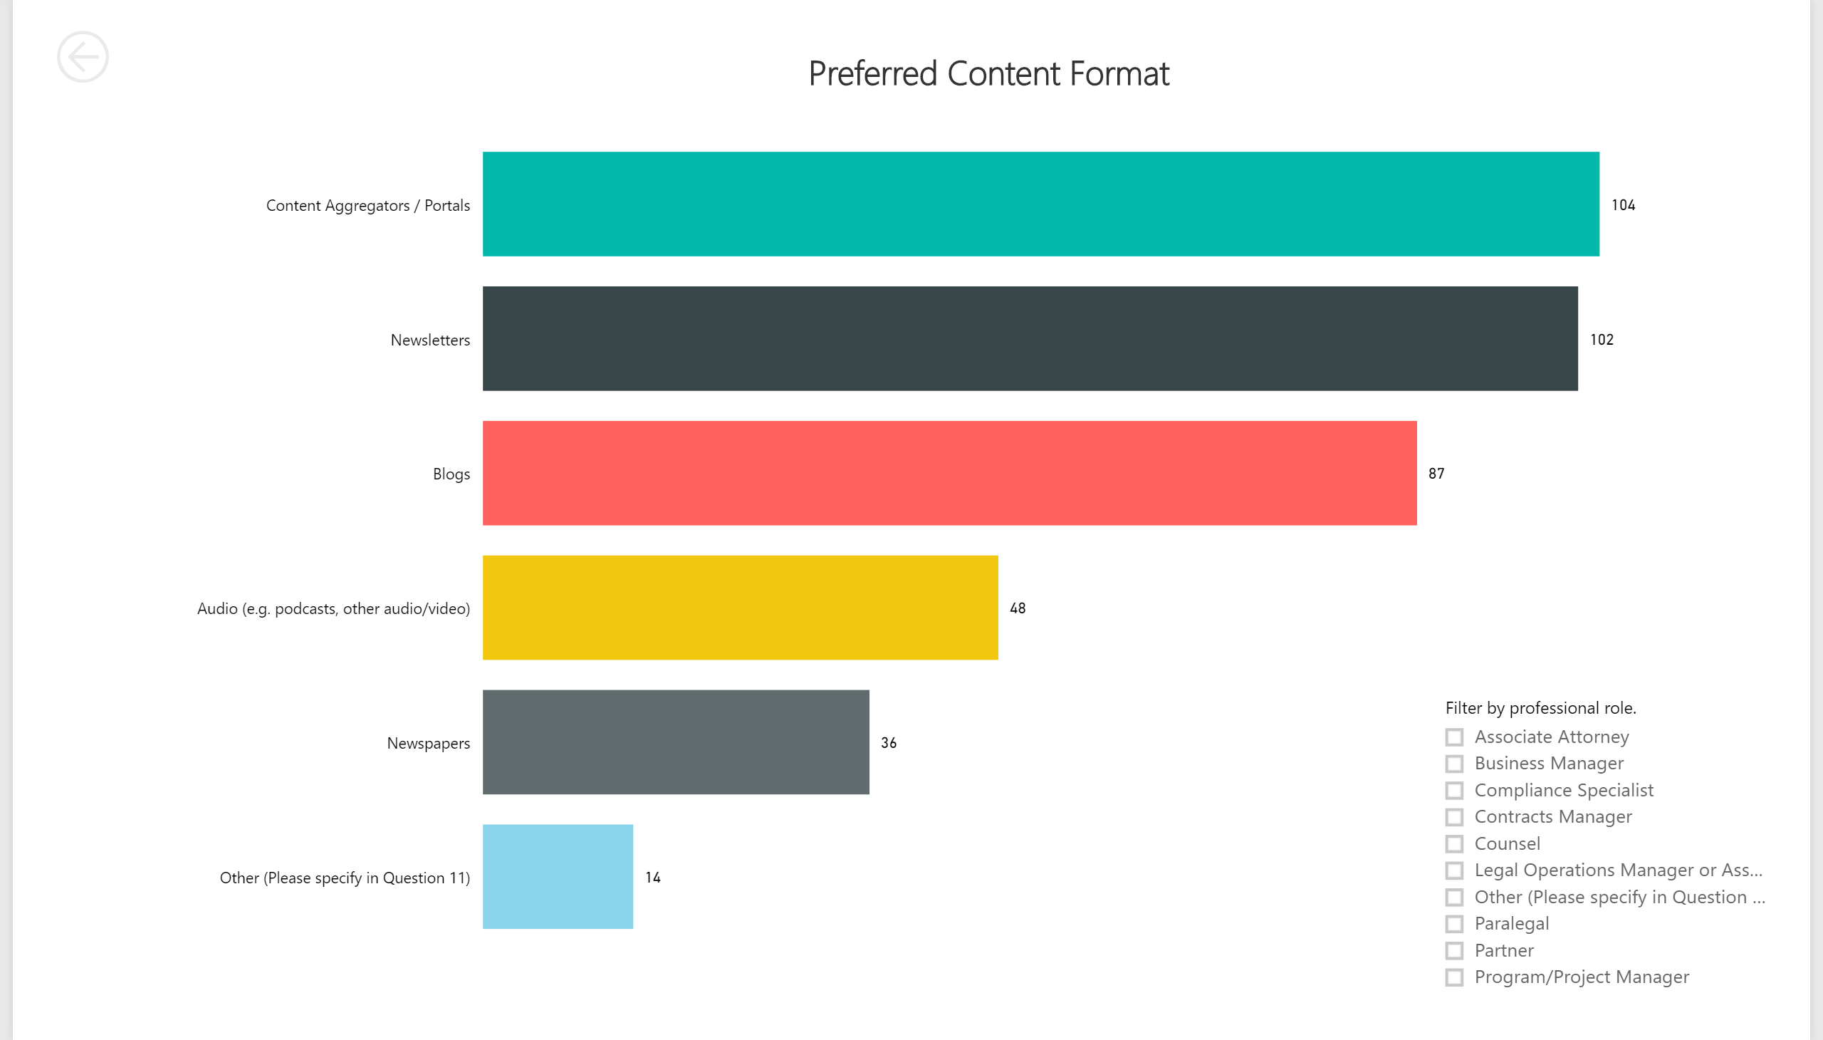

Slide 5
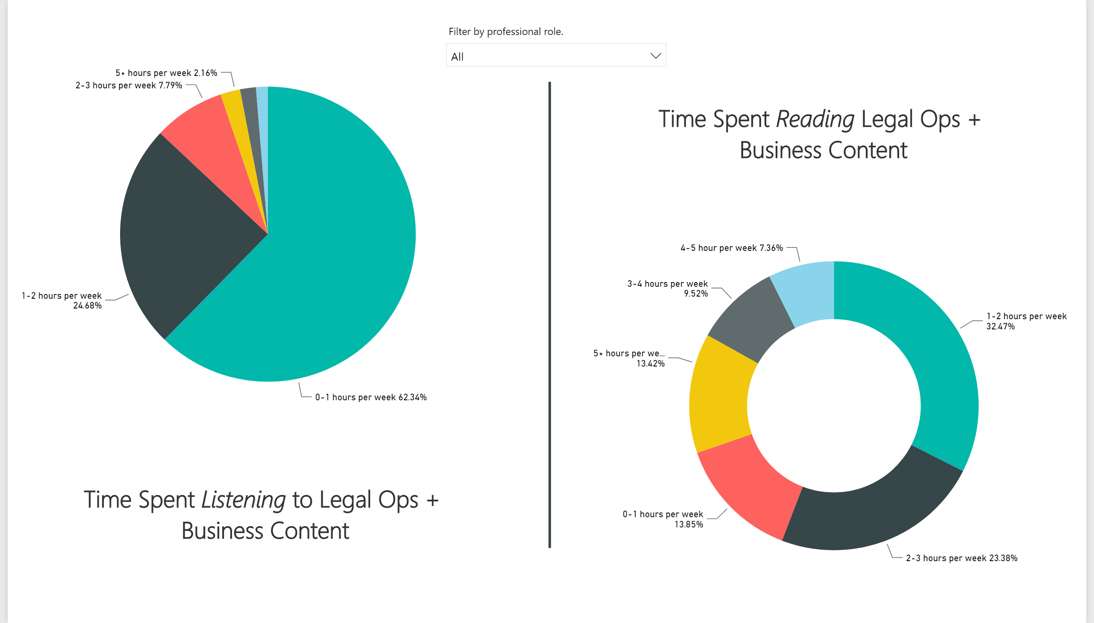

Slide 6
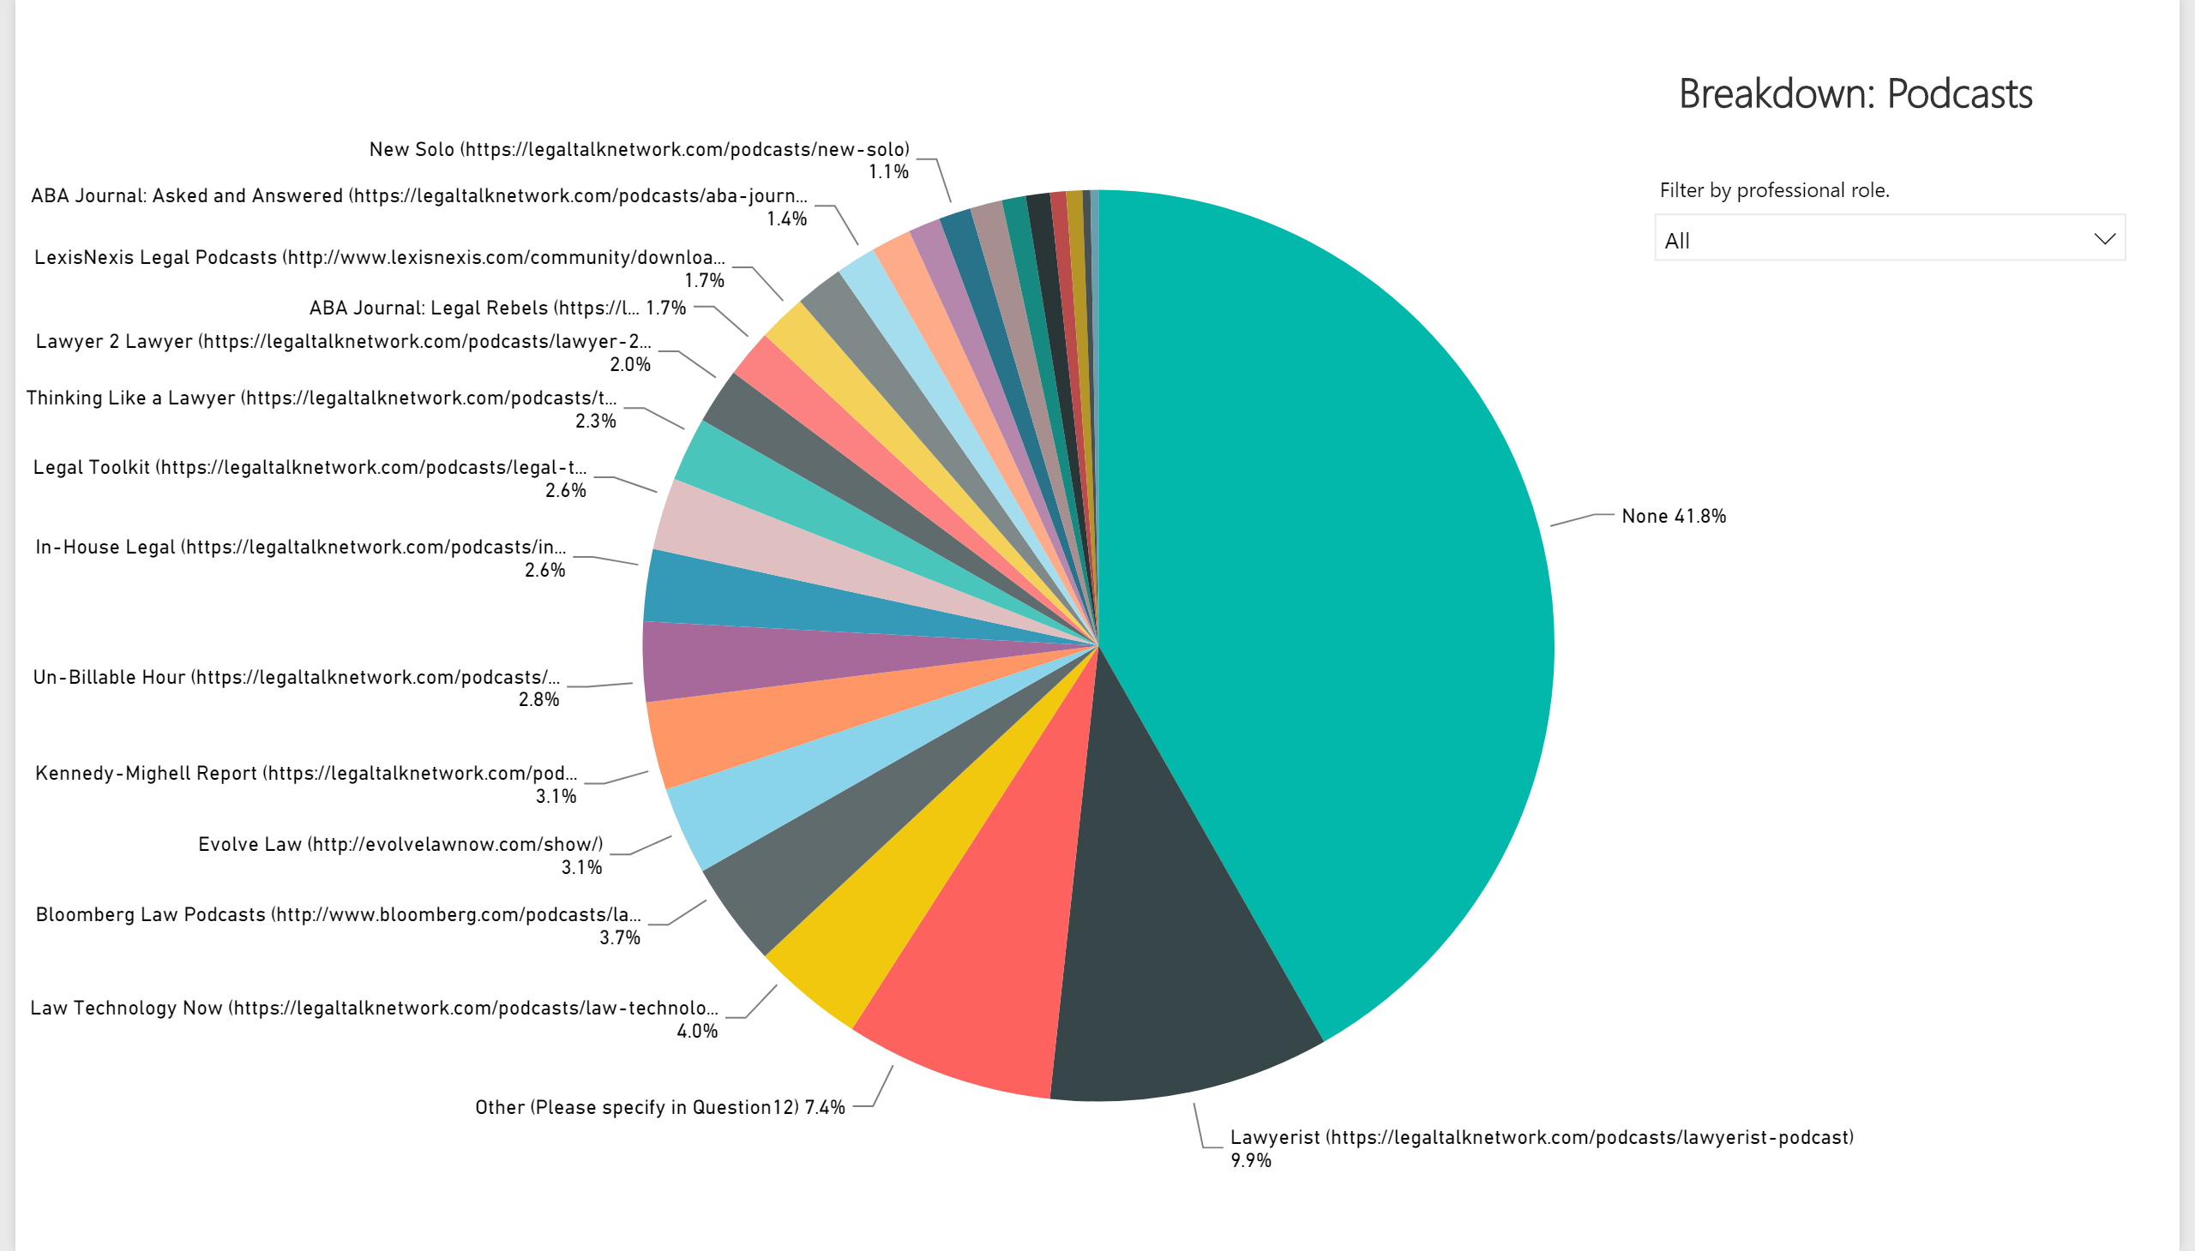

Slide 7
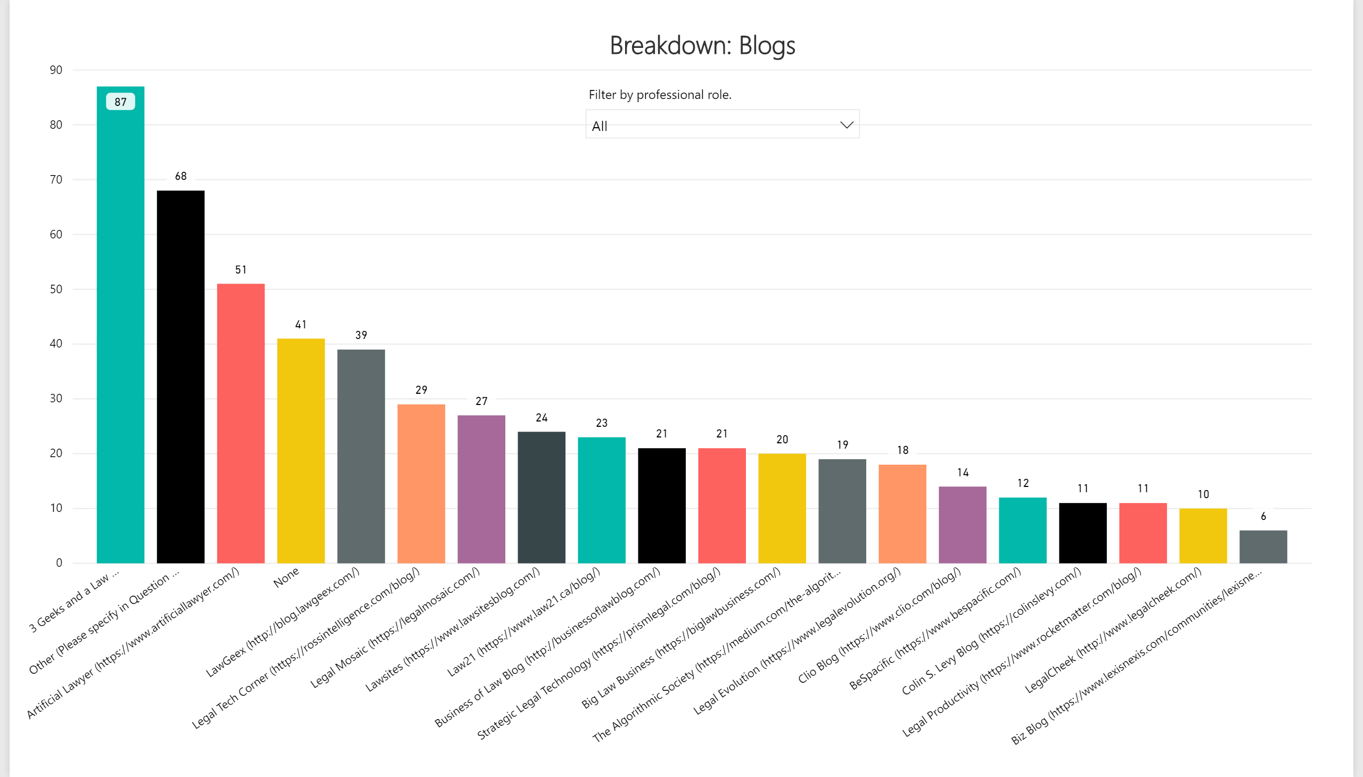

Slide 8
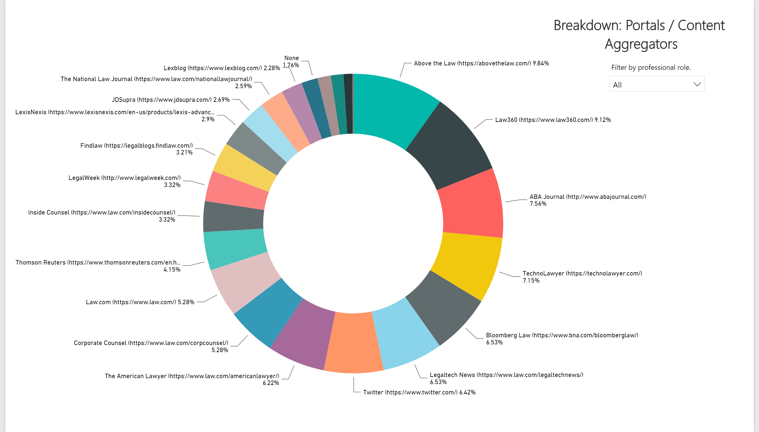

Slide 9
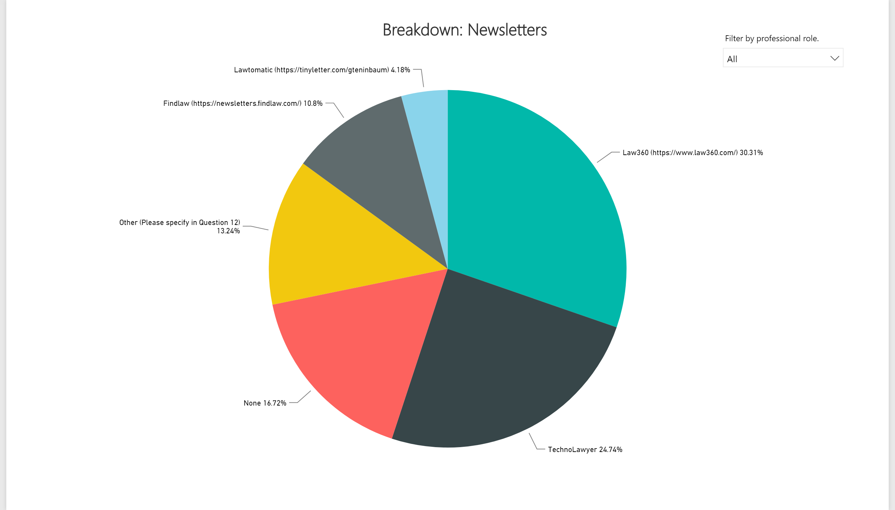

Slide 10
